Slide 1

Employee Management System
Presented By:
J.AnudeepKumar
B.SaiVamshi
S.Karthik
Batch No:460

Slide 2
Agenda
Objective of the Project
ER Diagram and schema explanation
Key analysis questions (use cases)
SQL query results with screenshots or summaries
Final business insights and recommendations
Conclusion (Key finding overall)
Q&A Slide

Slide 3
Business Problem and Statement
PROBLEM: Organizations often struggle to manage employee data efficiently due to fragmented systems and manual processes. This leads to errors in payroll, difficulty in tracking employee performance, leave management issues, and lack of actionable insights for decision-making.
SOLUTION: There is a need for a centralized system that can store, manage, and analyze employee-related data such as job roles, salaries, qualifications, and attendance.

Slide 4
Introduction
In today’s fast-growing corporate environment, managing employee information effectively is crucial for organizational success. Human Resource departments handle large volumes of data including employee records, payroll, job roles, and leave details.
An SQL-based Employee Management System provides a structured way to store, retrieve, and analyze this data. By using relational databases, organizations can ensure data accuracy, reduce redundancy, and generate meaningful insights to support strategic decisions.

Slide 5
Objective of the Project
The objective of this project is to develop an SQL-based Employee Management System that efficiently organizes and manages all employee-related information, including job roles, salary details, qualifications, leave records, and payroll. The system aims to ensure data accuracy, streamline HR processes, and provide actionable insights to support informed decision-making by management and human resources teams.

Slide 6
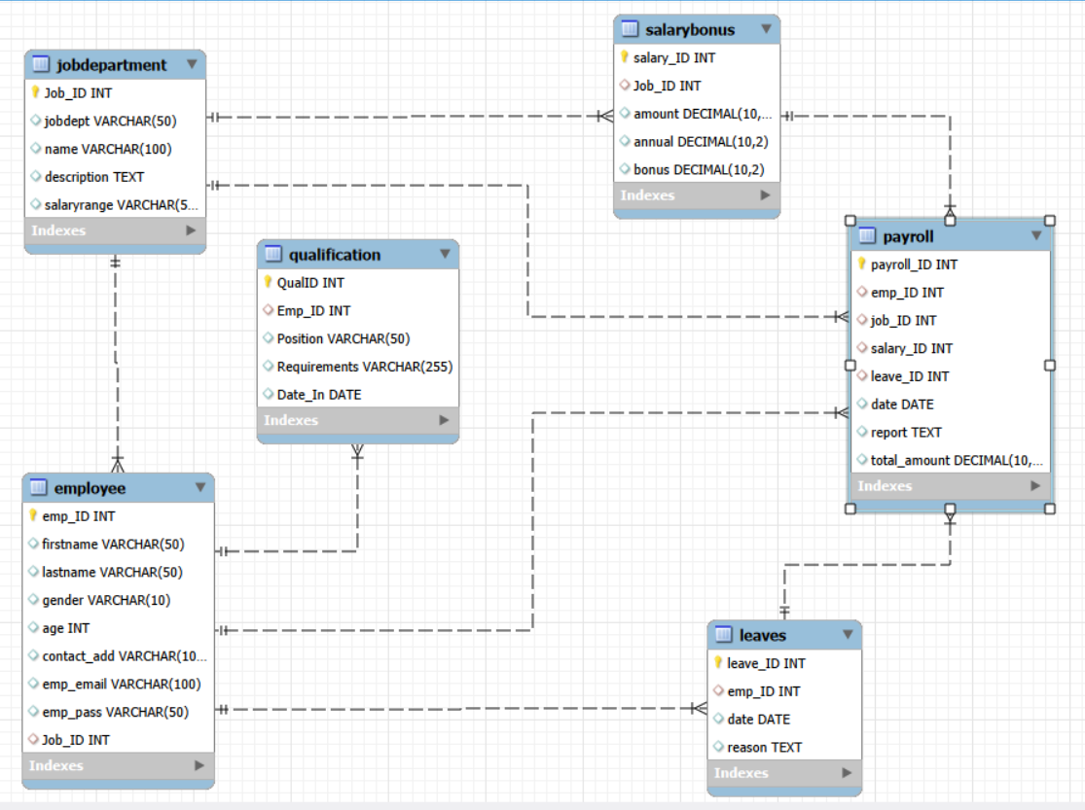
ER Diagram and schema explanation

Slide 7
SQL Concepts Demonstrated
Relational database design
CREATE TABLE and constraints
PRIMARY KEY and FOREIGN KEY
JOIN operations
GROUP BY and aggregate functions
ORDER BY and filtering
Business-oriented SQL analysis

Slide 8
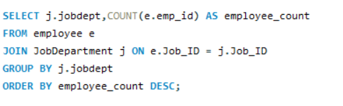
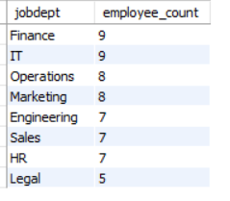
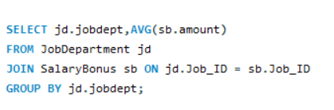
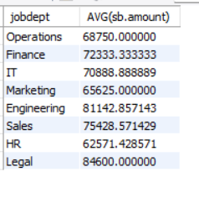
Key analysis questions
1.2 Which departments have the highest number of employees?
What is the average salary per department?

Slide 9
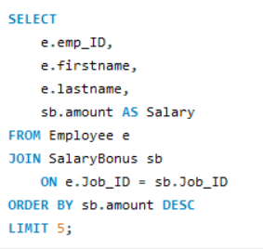
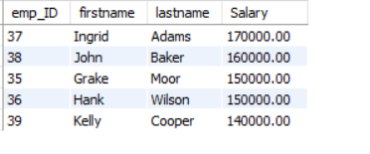
Who are the top 5 highest-paid employees?

Slide 10
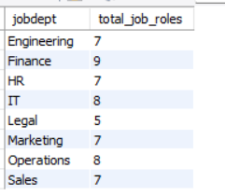

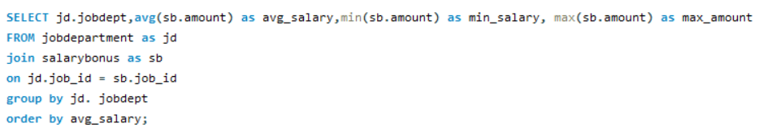
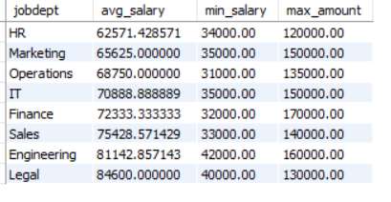
2. JOB ROLE AND DEPARTMENT ANALYSIS
2.1 How many different job roles exist in each department?
2.2 What is the average salary range per department?

Slide 11
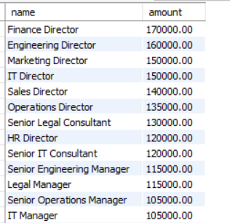
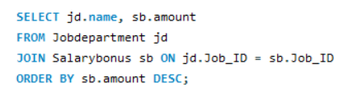
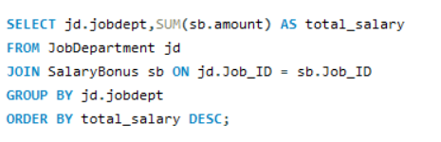
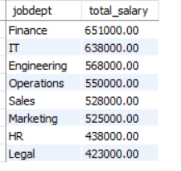
Which job roles offer the highest salary?
Which departments have the highest total salary allocation?

Slide 12
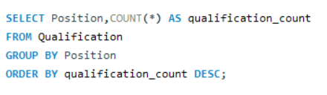
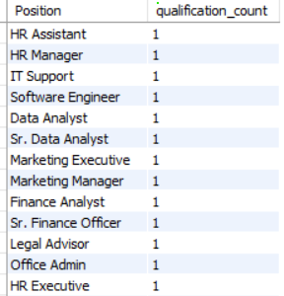
3. QUALIFICATION AND SKILLS ANALYSIS
Which positions require the most qualifications?

Slide 13
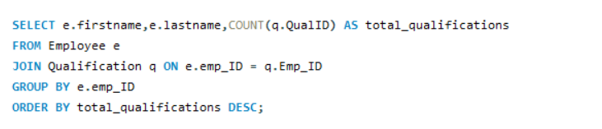
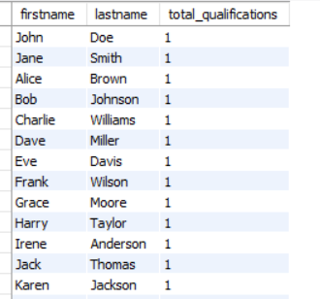
Which employees have the highest number of qualifications?

Slide 14
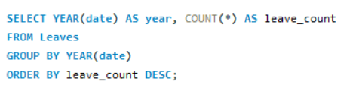

4. LEAVE AND ABSENCE PATTERNS
Which year had the most employees taking leaves?

Slide 15
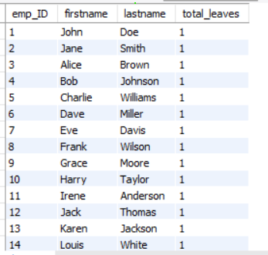
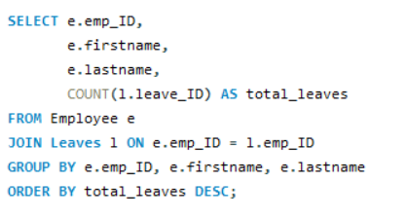
Which employees have taken the most leaves?

Slide 16
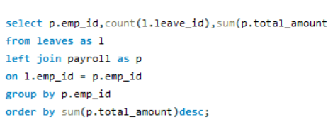
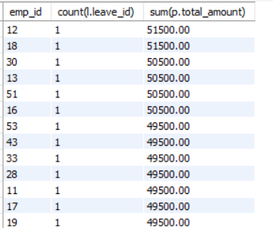
How do leave days correlate with payroll amounts?

Slide 17
Insights
The analysis of employee data revealed several important patterns:
Certain departments have significantly higher employee counts, indicating workforce concentration.
Salary distribution varies widely across job roles and departments.
A small number of employees account for a large portion of payroll expenses.
Employees with more qualifications tend to hold higher-paying positions.
Leave patterns show peak periods where absenteeism increases.

Slide 18
Recommendations
Based on the insights:
Balance workforce distribution across departments to avoid overload.
Review salary structures to ensure fairness and competitiveness.
Provide training programs to increase employee qualifications.
Implement leave planning policies during peak absence periods.
Use data-driven strategies for hiring and promotions.

Slide 19
Conclusion
The SQL-based Employee Management System successfully demonstrates how relational databases can be used to manage and analyze employee data efficiently. The system enables accurate tracking of employee information, simplifies HR operations, and provides valuable insights for decision-making.
Overall, the project highlights the importance of data-driven management in improving organizational productivity and planning.

Slide 20
Any Queries?

Slide 21

THANK YOU

